Slide 1
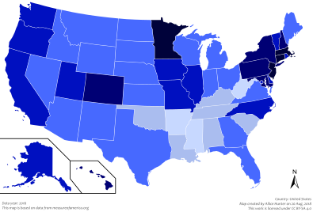
“DISTANCE LEARNING”
Means we are not here in the same room but we are never far from each other!

Slide 2
You need to know
Learning continues – the virus does not slow or stop our objective…
What is that?
Our expectations of each other have not changed.. but maybe our sleeping habits have …so my office hours are 8-4. If the hours change, I will send everyone a message on Remind.
I am checking email and Remind frequently throughout the day.
You may email or send me a message on Remind when you have questions.
All assignments will be posted in our class folder each day by 10:00 am. Parents these are invitation only folder, if you would like to see what your child’s assignments are ask he/she to access the folder and show you.

Slide 3
And if you or your family need anything
You may find me here
email: prescsy@boe.richmond.k12.ga.us
Message me on Remind
I will schedule a weekly Zoom session so that we can “see” each other and answer questions.
“In every crisis, doubt or confusion, take the higher path - the path of compassion, courage, understanding and love.”
Amit Ray

Slide 4
Tips to Help Us (You and ME)Make it Work
Decide to carve out a specific time a day to do the class work.
Pretend you are in an actual ARJ classroom ...yes it is hard for me too!!!
Eliminate distractions. Close the door and shut off technology not related to the class.
We are designing the work to be done in a small capsule of time.. commit to that amount of time!

